Slide 1

By: Andy Anguiano

Slide 2


Problem
Data that is essential to the business is stored in many different places. “Old school” ways of inefficient data keeping cause disorganized business. There are many parts, many suppliers, many customers.

Slide 3
Solution
Build a database where business operation information can be stored in order to efficiently gather, analyze, and store data. Provide new insight which is not able to be gathered from third party service

Slide 4
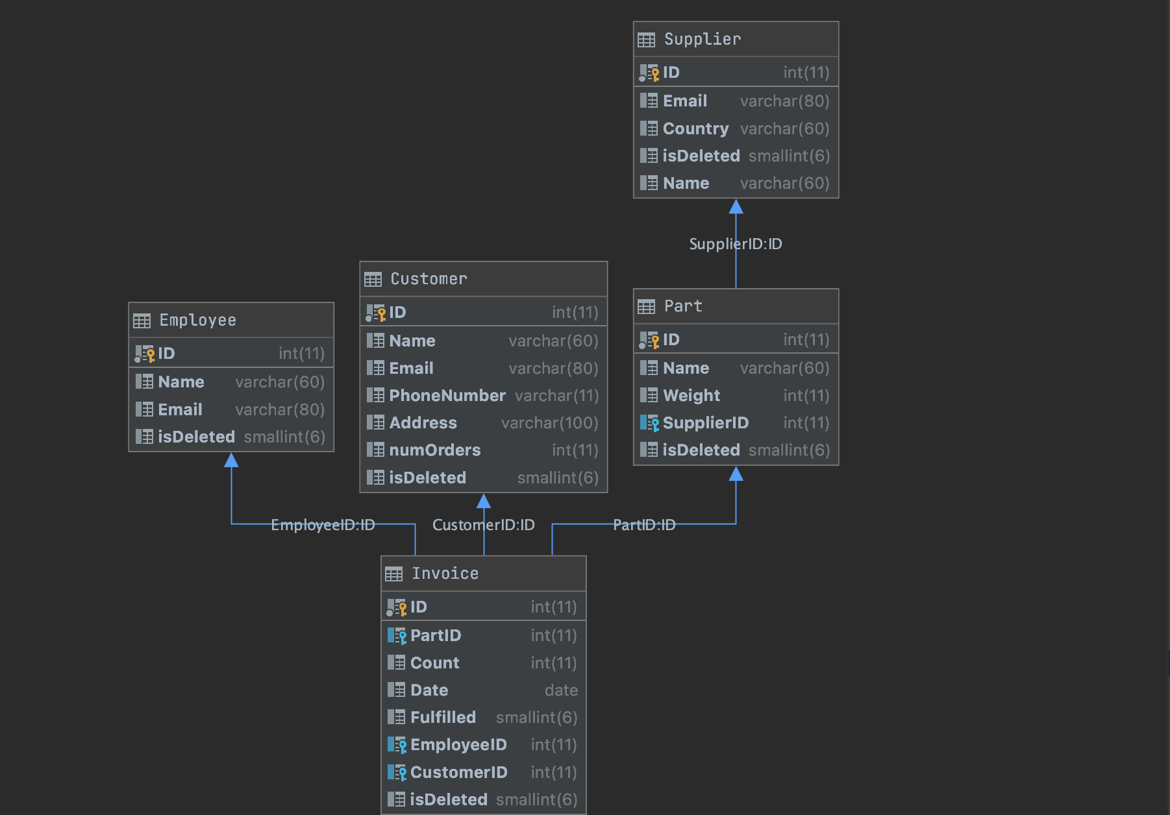
SCHEMA

